Slide 1
A usable guide to architecture and algorithms
A distillation of random amateurish wanderings through Supercomputing and Coding space

Slide 2
The comms and Memory hierarchy and efforts to solve it- quarts into pint pots
I’m a photon transport in media modeller, so I view the world in terms of flows and these flows change the state of the media they interact with and the flows themselves.
This is the key concept that helped me as I had a ready-made mental toolkit to abstract out what is happening in servers and clusters

Slide 3
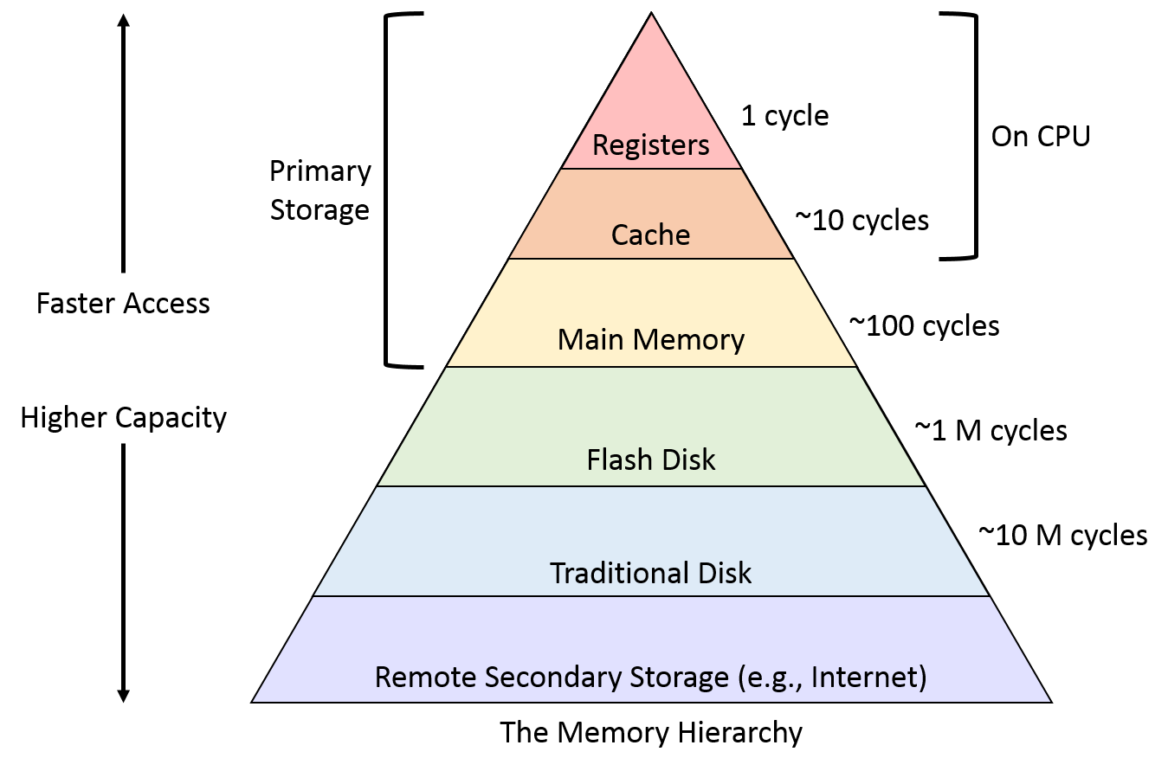
The memory hierarchy
Your data – instructions and data you are working on, flow up and down this hierarchy.
Bandwidth increases as you go up the hierachy
The latency – wait time – is given in terms of Processor Unity cycles
For low latency clusters with latency of 1-2 microsecs, we get waits of >3000-6000 cycles for PU-PU comms
Internal to the server the PUs tend to share the same Ram and Cache, so wait times are >100 cycles

Slide 4
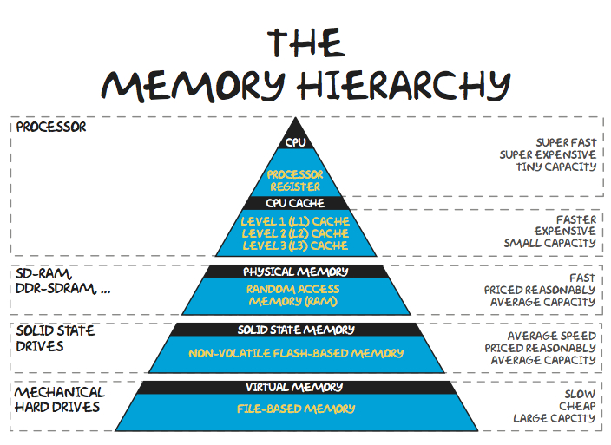
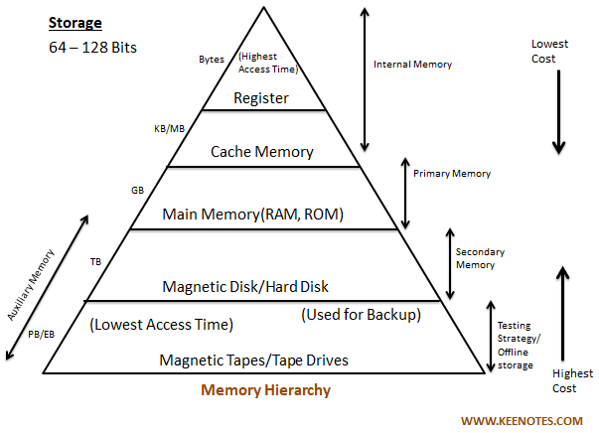
Other views of the memory hierarchy

Slide 5
Jeremy’s History Crib
There was once a time when all supercomputers were shared memory machines. The RAM was equally accessible to all execution elements in the machine.
Life was simpler
As our problems grew in size it became clear by the mid 90s that large SMP machines were going to be too expensive
The solution was to federate SMP machines of various sizes using fast low latency networks
I bought a SMP SGI Origin2000 in 1998 for £200k – 24 cores
In 2001 I bought 8 Sunfire 880s in a myrirnet network – 128 cores
EPCC developed the MPP systems with 1024 alpha chips
HPC-X used IBM severs in a Federation Switch Network
Lattice QCD built a massively parallel system based on games chips
Life has not been simpler – bottlenecks began to appear immediately.
The primacy of Intel and AMD CPUs – ascendancy achieved between 1995 and 2005 (fp64) made chips and servers much cheaper
However we lost RISC in favour of CISC
We lost vectorization (until 2005-7) and new codes became “unvectorised/able”
Increases in CPU clock speeds make up for these losses

Slide 6
Clusters using commodity servers were built successfully from about 2004 onwards
Improvements in networking (interconnect) technology allowed this.
Parallel data striping also increased
Cheaper high performance switches
However, code efficiencies remained low (<1-10%) and scaling issues have been a perennial problem
By 2012 it became clear that the standard cluster design could not support some workloads in Lattice QCD and Smooth Particle Hydro.
In the UK DiRAC 2 was formed to meet this challenge with 3 systems designs to deal with
Spectral methods and unstructured grids (SPH)
Sparse matrix algebra (LQCD) – the TURSA system is designed to solve this problem – it is a mathematical manifestation of the algorithmic requirement
Dense matrix algebra and High IO (Spectroscopy)

Slide 7
Vectorisation
SIMD is short for Single Instruction/Multiple Data, while the term SIMD operations refers to a computing method that enables processing of multiple data with a single instruction. In contrast, the conventional sequential approach using one instruction to process each individual data is called scalar operations.
GPUs are SIMD machines
CPUs have SIMD vector lanes
Most codes are not well vectorized and given most of the extra flop counts are due to vectorized the %use of most cores is dire.
multiple instruction, multiple data is a technique employed to achieve parallelism. Machines using MIMD have a number of processors that function asynchronously and independently. At any time, different processors may be executing different instructions on different pieces of data.
Clusters and servers are MIMD machines

Slide 8
The 13 motifs of parallel programming
Dense Matrix Algebra: Matrix Multiply
Sparse Matrix Algebra: Matrix Vector Multiply
Spectral Methods: 2D FFT
N-Body Methods
Structured Grid: Laplace’s equation with Dirichlet’s conditions on the square
Unstructured Grid: 2D Iterative Triangular Grid
MapReduce: a framework for processing parallelizable problems across large datasets using a large number of computers
Combinational Logic: Popcount on a binary string
Graph Traversal: Depth First Search
Dynamic Programming: 0/1 Knapsack Problem
Backtrack and Branch-and-Bound: Traveling Salesman problem
Graphical Models: Viterbi Algorithm for Hidden Markov Models
Finite State Machines: Pattern Matching on Strings

Slide 9
How did the algorithms affect the Design
How often and how locally is the array updated as the instruction set works on it.
If the elements don’t affect each other then mapreduce
If it is not much and just the surrounding elements then you can spread your array all over the RAM in the cluster – sparse matrix algebra, N-Body
If a lot of updating is going on but still local-ish you might find large SMP nodes in a low latency network is needed – dense matrix algebra
FFTs are the extreme (Spectral methods). As the changes are non-local, so spreading the array all over the cluster RAM causes huge delays
Have very high RAM nodes and limit the FFT to just one node
Use modern decomposition methods – Lattice QCD do the largest FFTs (not very well, but at least the problem is tractable)

Slide 10
A structured grid means that the volume elements are well ordered, and a simple scheme (e.g., I,J,K indices) can be used to label elements and identify neighbors.
Easier to distribute over RAM on a cluster
In unstructured grids, volume elements can be joined in any manner, and special lists must be kept to identify neighboring elements.
Complex interconnects are used to mitigate this
LQCD use this approach
Basically we aim to optimise are around
Memory bandwidth – CPU-RAM comms
IO bandwidth and latency
Cluster bandwidth and latency
Key concepts are to make sure the end to end flow of data around the cluster and on chip minimises the amount of wasted cycles
The flow is smooth without blocking and backing up

Slide 11
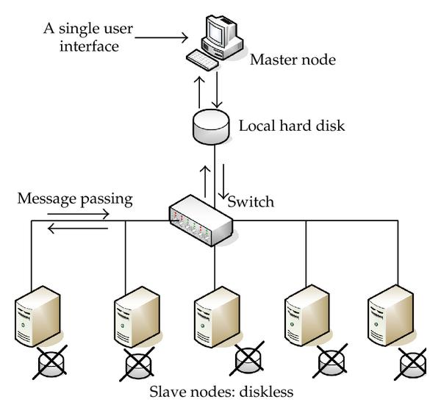
Cluster Architecture
A simple cluster architecture
The key components are the nodes which contain the CPU/GPU and the RAM
The Switch and Network that allow communications between nodes.

Slide 12
ExCALIBUR H&ES Projects – Blockages and Pinchpoints
Cerebras Waferscale Testbed– a huge SIMD array
RISC-V – using reduced instruction sets so chips use less energy
ExCALIDATA and the H&ES Wafer Scale Exascale IO Testbed – addressing bottlenecks in the IO system and IO software
Benchmarking for Performance Portable ExCALIBUR Applications
Rockport testbed – switchless networking
Storage and RAM as service – enabling servers to borrow RAM
Adaptable Cluster Project
ARM+GPU Testbed
AMD GPU Testbed
FPGA TestBed
Graphcore testbed

Slide 13
Key Metrics – System performance
We have been able to measure the characteristics of clusters using synthetics using the HPC Challenge framework.
Great for making sure the equipment works
The HPC Challenge benchmark consists of basically 7 tests:
HPL - the Linpack TPP benchmark which measures the floating point rate of execution for solving a linear system of equations.
DGEMM - measures the floating point rate of execution of double precision real matrix-matrix multiplication.
STREAM - a simple synthetic benchmark program that measures sustainable memory bandwidth (in GB/s) and the corresponding computation rate for simple vector kernel.
PTRANS (parallel matrix transpose) - exercises the communications where pairs of processors communicate with each other simultaneously. It is a useful test of the total communications capacity of the network.
RandomAccess - measures the rate of integer random updates of memory (GUPS).
FFT - measures the floating point rate of execution of double precision complex one-dimensional Discrete Fourier Transform (DFT).
Communication bandwidth and latency - a set of tests to measure latency and bandwidth of a number of simultaneous communication patterns; based on b_eff (effective bandwidth benchmark).

Slide 14
Key Metrics – Code performance
How do individual codes use the system?
This has always been possible, but requires an awful lot of work.
This is key for performant code
Making this task tractable and easy to use for developers has been difficult. A lot of money has been spent on various packages.
Culturally we are trained to build correct and stable code.
Performance is done at the end of the project and it is not done for the simple reason it can be as time consuming as the first 2 steps.
We are not trained to think about performance
It’s only the move to GPU that is causing a serious rethink

Slide 15
The H&ES REFRAME+SPACK+PROFILER Project
The following projects have teamed up to produce a simple to use profiler tool that is portable between systems.
The team members are
Benchmarking for Performance Portable ExCALIBUR Applications (Ilektra, Tuomas, Mose, Jeremy – UCL, Tom - Bristol)
Blueprint for AI Systems at Scale – BASE-II (Bob, Chris and Roger – Cambridge, Jeremy - UCL, Juri - STFC SCD, Mark - Leicester)
UK SKA Regional Centre (Marcus- UCL)
Exascale IO Testbed (Bob and Roger – Cambridge)
Look out for the training event at CIUK – Manchester 4-6 December 2024

